Slide 1
RTOS - Based Railway Crossing Automation System
Group - 3
1
250850130004 - A. Rohith Naga Sai
250850130012 - Dhanush Gowda K
250850130017 - Kapil Rajgopal
250850130021 - Konakalla Vivek Sri Krishna Chaitanya

Slide 2
AGENDA
Introduction
Hardware and Software components
Nucleo - STM32H753ZI
LED and Buzzer
IR sensor
Ultrasonic sensor
Servo Motor
Without RTOS
With RTOS
Conclusion

Slide 3
Introduction
In this project, we developed a fully automated railway level crossing gate system to eliminate accidents caused by human error in traditional manual operations. Using the high-performance Nucleo-STM32H753ZI development board powered by the STM32H7 microcontroller, we integrated two independent servo-controlled gates with real-time safety features.
Train arrival is detected by an IR sensor on the entrance side (Gate-1), triggering both gates to close smoothly in 10° steps. Ultrasonic sensors monitor for obstacles (vehicles or people) under each gate during closing - if detected, the affected gate pauses at 90° until clear, while the other continues independently. Once both gates are closed, a short delay allows the train to pass safely. Train exit is detected by the second IR sensor (Gate-2), opening the gates after a brief delay.
Clear visual feedback comes from traffic lights (red during closing/passing, yellow warning, green when open) and audible alerts from buzzers. We implemented both bare-metal (without RTOS) and FreeRTOS-based versions for comparison, achieving reliable, responsive control suitable for real-world safety applications. The system includes detailed UART logging for debugging and monitoring.

Slide 4
Hardware and Software components
Hardware Components
Nucleo - STM32H753ZI development board (main MCU)
2 × MG995 Servo Motors (high-torque gate control, 180° rotation)
2 × HC-SR04 Ultrasonic Sensors (obstacle detection, 2 - 400 cm range)
2 × IR Infrared Obstacle Avoidance Sensors (train arrival/exit detection, active low)
2 × LED Traffic Light Modules (Red/Yellow/Green signals for road users)
2 × 5V Active Electromagnetic Buzzers (audio warnings)
Jumper wires for connections, breadboard, separate 5V and 3.3V power supply for servos (high current) and other sensors, and USB for debugging such as UART logging.
Software Tools
STM32CubeIDE → Primary IDE for code development, HAL configuration, FreeRTOS setup, debugging, and code generation from STM32CubeMX.
Proteus → Used for simulation and virtual testing for some of the circuits before hardware implementation.

Slide 5
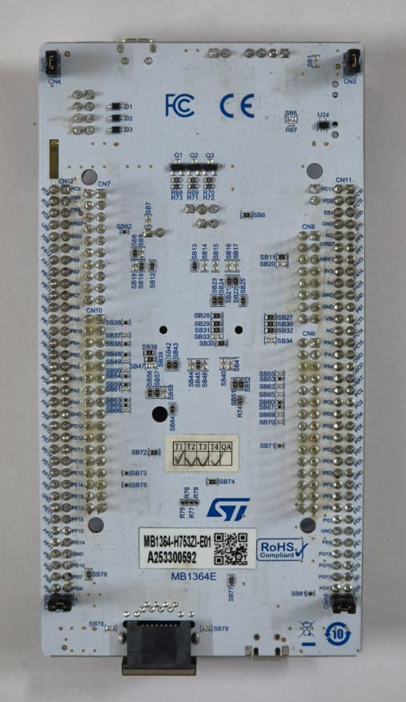
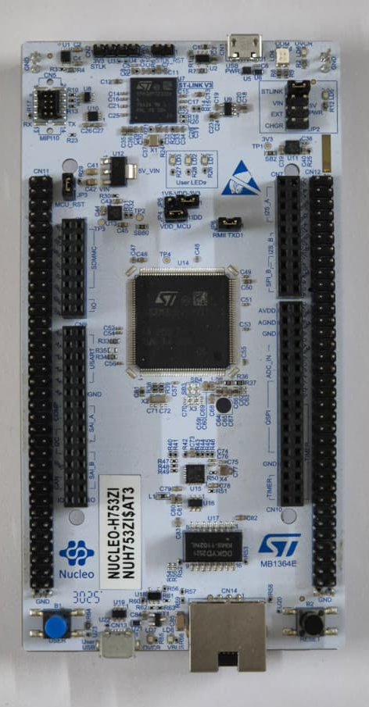
Nucleo - STM32H753ZI
The Nucleo - STM32H753ZI (Arm® Cortex®-M7 32-bit RISC core) is a powerful, high-performance development board from STMicroelectronics, ideal for demanding real-time and industrial applications like our railway gate system.
Key Specifications
MCU: STM32H753ZI
Clock Speed: Up to 480 MHz
Flash Memory: 2 MB
SRAM: 1 MB
Advanced Peripherals: Multiple timers (PWM, Input Capture), Ethernet, USB OTG HS/FS, cryptographic acceleration
Connectivity: Arduino Uno V3, ST Zio, and Morpho connectors for easy expansion
On-board Debugger: ST-LINK/V3E (USB, SWD, JTAG support)
Power Flexibility: USB or external 7 - 12 V supply
Compact Form: Nucleo -144 format for prototyping
This board provides the processing power and timer resources needed for precise servo PWM, ultrasonic capture, and FreeRTOS multitasking.

Slide 6
LED and Buzzer
LED Traffic Light Module - This is a compact digital signal module simulating real traffic lights with three high-brightness LEDs (Red, Yellow, Green).
Working Principle:
Common - cathode design - LEDs share a common ground. Applying HIGH (5V) to individual control pins (R/Y/G) turns the corresponding LED ON. Can connect to PWM pins for brightness control if needed.
5V Active Electromagnetic Buzzer - A simple audio alert device.
Working Principle:
Contains an internal oscillator and electromagnetic coil. Applying a steady 5V DC signal activates the coil, causing a diaphragm to vibrate at ~2048 Hz, producing a loud beep (~80 dB at 10 cm). No external frequency generation required - just ON/OFF control.

Slide 7
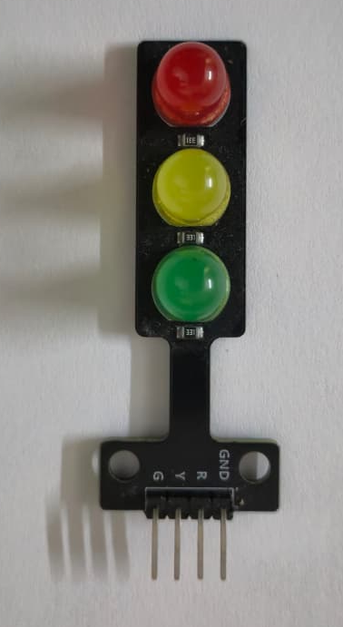

LED and Buzzer
LED Traffic Light Module
Pinout: VCC (5V), GND, R (Red control), Y (Yellow control), G (Green control)
STM32 Connections (Gate-1): PA5 → Red, PA6 → Yellow, PA7 → Green (Gate-2): PE2 → Red, PE3 → Yellow, PE4 → Green
Advantages
Bright and visible, simple digital control, low power, durable for models
Disadvantages
Fixed colours (no RGB mixing), requires 5 separate pins for two modules, no built-in blinking logic
5V Active Buzzer
Pinout: Two pins (longer = signal, shorter = GND)
STM32 Connections (Gate-1): PA9, (Gate-2): PE5
Advantages
Very loud for alerts, easy to drive (just digital HIGH/LOW), compact and cheap
Disadvantages
Fixed tone (no melody), continuous tone can be annoying if not timed, draws ~30–50 mA when ON
Applications
Railway/traffic signalling models, Automation alerts and warnings, Educational robotics and IoT projects

Slide 8
LED and Buzzer
// LED and Buzzer Control Functions
void TurnOffAllFeedback() {
// Reset all LEDs and Buzzers (Gate-1 and Gate-2)
HAL_GPIO_WritePin(GPIOA, GPIO_PIN_5 | GPIO_PIN_6 | GPIO_PIN_7 | GPIO_PIN_9, 0);
HAL_GPIO_WritePin(GPIOE, GPIO_PIN_2 | GPIO_PIN_3 | GPIO_PIN_4 | GPIO_PIN_5, 0);
}
void BlinkRedAndBuzzBoth() {
// Turn ON Red LEDs + Buzzers (both gates)
HAL_GPIO_WritePin(GPIOA, GPIO_PIN_5 | GPIO_PIN_9, 1);
HAL_GPIO_WritePin(GPIOE, GPIO_PIN_2 | GPIO_PIN_5, 1);
}
// Initialization (safe starting state)
TurnOffAllFeedback();
HAL_GPIO_WritePin(GPIOA, GPIO_PIN_7, 1); // Green Gate-1 ON
HAL_GPIO_WritePin(GPIOE, GPIO_PIN_4, 1); // Green Gate-2 ON

Slide 9
IR sensor
IR Infrared Obstacle Avoidance Sensor
It is a simple, low-cost module used to detect objects or interruptions (like a train blocking the path).
Key Features
Detection range: 2 - 30 cm (adjustable with potentiometer)
Output: Digital (Active Low - HIGH when clear, LOW when obstacle detected)
Operating voltage: 3.3V - 5V
Working Principle
An IR LED emits invisible infrared light continuously.
A photodiode receives the reflected light when an object is present.
When reflection is strong (obstacle close), the comparator outputs LOW (active).
When no reflection (clear path), output stays HIGH.
Built-in potentiometer lets us adjust sensitivity for distance.
This makes it perfect for detecting train arrival or exit in our railway gate system.

Slide 10
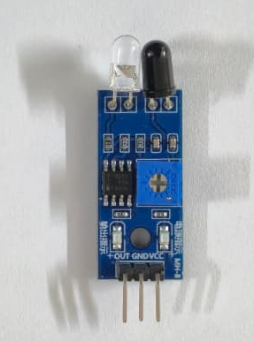
IR sensor
Pinout (3 - pin module)
VCC → 3.3V
GND → Ground
OUT → Digital output (active low)
STM32 Connections
Gate-1 (Train Arrival): PA0 → OUT (GPIO Input), Gate-2 (Train Exit): PF0 → OUT (GPIO Input)
Advantages
Very cheap and simple, Fast response (no moving parts), Easy digital output (just read pin), Works in dark
Disadvantages
Short range (max ~30 cm), Affected by sunlight, surface colour, dust, Fixed detection angle
Applications
Train detection, Obstacle avoidance in robots, Line following, door sensors, Automation projects

Slide 11
IR sensor
// IR Sensor Test (Gate-1 example)
uint8_t last_ir = GPIO_PIN_SET; // Previous state
while(1) {
uint8_t ir = HAL_GPIO_ReadPin(GPIOA, GPIO_PIN_0); // Read PA0
if (ir == GPIO_PIN_RESET && last_ir == GPIO_PIN_SET) {
// Train detected (falling edge)
Print("IR Gate-1: Train Coming!\r\n");
BlinkRedAndBuzzBoth(); // Alert with LED + Buzzer
HAL_Delay(500); // Simple debounce & alert time
}
last_ir = ir;
HAL_Delay(50); // Poll every 50 ms
}

Slide 12
Ultrasonic sensor
HC-SR04 Ultrasonic Range Finder
Low-cost, non - contact distance sensor used to detect obstacles under the gate.
Working Principle
Sends a short 10 µs trigger pulse → emits 8 bursts of 40 kHz ultrasonic waves.
Listens for reflected echo from object.
Measures time between trigger and echo.
Distance = (time × speed of sound) / 2 (speed ≈ 0.0343 cm/µs at room temperature)
Range: 2 cm to 400 cm (ideal 2 - 200 cm for accuracy).
In our project: One sensor per gate checks for the presence of vehicles/people during closing state only.

Slide 13
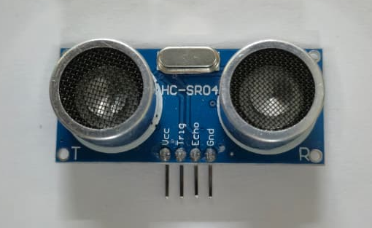
Ultrasonic sensor
Pinout (4 - pin module)
VCC → 5V
Trig → Trigger pulse (output from MCU)
Echo → Echo pulse (input to MCU)
GND → Ground
STM32 Connections
Gate-1: PB2 → Trig (GPIO Output), PB1 → Echo (TIM3_CH4 Input Capture)
Gate-2: PB9 → Trig (GPIO Output), PB8 → Echo (TIM4_CH3 Input Capture)
Advantages
Accurate, non-contact, wide range, immune to light/colour.
Disadvantages
Affected by soft surfaces/temp, blind zone < 2 cm, needs 5V.
Applications
Obstacle detection, parking sensors, robotics, level crossing.

Slide 14
Ultrasonic sensor
// Ultrasonic Test (Gate-1 example)
float Get_Ultrasonic_Distance_Gate1() {
HCSR04_Trigger_Gate1(); // Send 10µs pulse on PB2
HAL_Delay(60); // Wait for echo
return distance_cm_gate1; // Updated by TIM3 callback
}
// In main loop while(1) {
float dist = Get_Ultrasonic_Distance_Gate1();
if (dist >= 2.0f && dist <= 15.0f) {
Print("Obstacle detected! Distance: %.1f cm\r\n", dist);
BlinkRedAndBuzzBoth(); // Alert
}
HAL_Delay(200);
}

Slide 15
Servo Motor
MG995 Servo Motor
High-torque digital metal-gear servo used to physically open/close the railway gates (180° rotation).
Working Principle
Controlled by PWM signal (50 Hz, pulse width 1 - 2 ms).
Pulse width determines angle:
  ~1 ms → 0° (closed)
  ~1.5 ms → 90°
  ~2 ms → 180° (open)
Internal potentiometer + feedback loop adjusts position precisely.
Metal gears give high torque (up to 12 kg . cm at 6V).
In our project: One servo per gate - moves in 10° steps during closing/opening, pauses at 90° if ultrasonic detects obstacle.

Slide 16
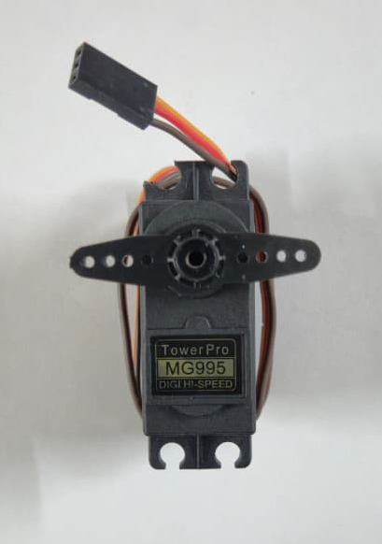
Servo Motor
Pinout (3 - wire cable)
Orange → Signal (PWM)
Red → Power (4.8 - 7.2V, usually 5 - 6V)
Brown → Ground
STM32 Connections
Gate-1: PA8 → Signal (TIM1_CH1 PWM)
Gate-2: PA15 → Signal (TIM2_CH1 PWM)
Advantages
High torque, precise position control, durable metal gears, easy PWM interface.
Disadvantages
Needs separate stable 5 - 6V power (high current), power-hungry when moving, slight jitter possible.
Applications
Railway gates, robotic arms, RC models, camera gimbals, automation projects.

Slide 17
Servo Motor
// Simple Servo Test (Gate - 1 example)
void SetServoGate1(float angle) {
__HAL_TIM_SET_COMPARE(&htim1, TIM_CHANNEL_1, Angle_to_CCR(angle));
}
// In main loop (test sweep)
float angle = 0.0f;
while(1) {
SetServoGate1(angle); // Set angle (0° to 180°)
Print("Gate-1 Angle: %.0f°\r\n", angle);
angle += 10.0f; // Move 10° each time
if (angle > 180.0f) angle = 0.0f;
HAL_Delay(200); // Wait 200 ms per step
}

Slide 18
Without RTOS
// IR detects train → close gate + blink red and buzz
// Simple flow: IR low → both gates close from 180° to 0° → red LEDs & buzzers blink during movement → steady when closed.
if (HAL_GPIO_ReadPin(GPIOA, GPIO_PIN_0) == GPIO_PIN_RESET) { // Gate - 1 IR
Print("Train Coming! Closing Gate...\r\n");
for (float angle = 180.0f; angle >= 0.0f; angle -= 10.0f) {
SetServoGate1(angle); // Move servo
SetServoGate2(angle); // Both gates sync
BlinkRedAndBuzzBoth(); // Red LED + Buzzer ON
HAL_Delay(200); // Smooth step
TurnOffAllFeedback(); // OFF for blink effect
HAL_Delay(200);
}
HAL_GPIO_WritePin(GPIOA, GPIO_PIN_5, 1); // Steady red
HAL_GPIO_WritePin(GPIOE, GPIO_PIN_2, 1);
HAL_GPIO_WritePin(GPIOA, GPIO_PIN_9, 1); // Steady buzz
}
18

Slide 19
Without RTOS
// While closing – check ultrasonic every step
// Simple flow: During gate closing → ultrasonic check → if obstacle (2 - 15 cm) → pause at 90° + alert → resume when clear → continue to 0°.
while (gate1_current_angle > 0.0f) {
float dist = Get_Ultrasonic_Distance_Gate1(); // Read sensor
if (dist >= 2.0f && dist <= 15.0f) { // Obstacle!
Print("Obstacle! Pausing at 90°\r\n");
SetServoGate1(90.0f);
BlinkRedAndBuzzBoth(); // Alert
HAL_Delay(1000); // Pause 1 sec
TurnOffAllFeedback();
} else {
gate1_current_angle -= 10.0f;
SetServoGate1(gate1_current_angle);
Print("Gate Angle: %.0f°\r\n", gate1_current_angle);
HAL_Delay(100); // Normal step
} }
19

Slide 20
Without RTOS
// Main logic (simplified flow - without RTOS)
Simple flow: IR1 low → warning → close both gates (10° steps) → pause if obstacle → both closed → wait → IR2 low → open gates → green lights ON.
if (HAL_GPIO_ReadPin(GPIOA, GPIO_PIN_0) == GPIO_PIN_RESET) { // Train arrival
Print("Train Coming!\r\n");
HAL_Delay(2000); // Yellow warning time (blink can be added)
sweeping_down = 1;
gate1_current_angle = 180.0f;
while (gate1_current_angle > 0.0f || gate2_current_angle > 0.0f) { // Gate 1 move + check
if (gate1_current_angle > 0.0f) {
float d1 = Get_Ultrasonic_Distance_Gate1();
if (d1 >= 2 && d1 <= 15) {
SetServoGate1(90.0f); HAL_Delay(1000); // Pause }
else {
gate1_current_angle -= 10; SetServoGate1(gate1_current_angle);
} }
BlinkRedAndBuzzBoth(); HAL_Delay(100); TurnOffAllFeedback();
}
Print("Both Closed – Train Passing\r\n");
HAL_Delay(3000); // Passing delay }
if (HAL_GPIO_ReadPin(GPIOF, GPIO_PIN_0) == GPIO_PIN_RESET) {
// Train exit
Print("Train Gone! Opening Gates\r\n");
HAL_Delay(1000);
// Open logic similar to close but angle += 10
TurnOffAllFeedback();
HAL_GPIO_WritePin(GPIOA, GPIO_PIN_7, 1); // Green ON
}
20

Slide 21
With RTOS
Pin Configurations
Gate-1 Ultrasonic: PB2 Trig, PB1 Echo (TIM3_CH4)
Gate-1 Servo: PA8 (TIM1_CH1 PWM)
Gate-1 LEDs/Buzzer: PA5 R, PA6 Y, PA7 G, PA9 Buzzer
Gate-2 IR: PF0 (Input)
Gate-2 Ultrasonic: PB9 Trig, PB8 Echo (TIM4_CH3)
Gate-2 Servo: PA15 (TIM2_CH1 PWM)
Gate-2 LEDs/Buzzer: PE2 R, PE3 Y, PE4 G, PE5 Buzzer
RTOS Key Setup (CMSIS_V2)
Tasks: Sensor1/2 (Above Normal), Servo1/2 (High), LEDBuzzer (Normal), UARTPrint (Low)
Event Flags: closeEvent, openEvent
Mutex: stateMutex (protect angles/count/state)
Queue: printQueue (20 items for logging)
Timebase: TIM6 (1 ms tick)
21

Slide 22
With RTOS
// LEDBuzzerTask - Handles visual/audio feedback
for(;;) {
if (system_state == 2 || system_state == 4) { // Moving (closing/opening)
BlinkRedAndBuzzBoth(); vTaskDelay(500);
TurnOffAllFeedback(); vTaskDelay(500); // Blink effect
}
else if (system_state == 3) { // Passing
BlinkRedAndBuzzBoth(); // Steady alert
}
else {
TurnOffAllFeedback(); // Green when idle
HAL_GPIO_WritePin(GPIOA, GPIO_PIN_7, 1);
HAL_GPIO_WritePin(GPIOE, GPIO_PIN_4, 1);
}
vTaskDelay(pdMS_TO_TICKS(50));
}
// SensorMonitor1Task - Detects train arrival (IR Gate - 1)
for(;;) {
if (HAL_GPIO_ReadPin(GPIOA, GPIO_PIN_0) == GPIO_PIN_RESET) { // Falling edge
Print("Train Coming! Gate-1 IR Triggered\r\n");
osEventFlagsSet(closeEvent, 0x01); // Wake both servo tasks
vTaskDelay(pdMS_TO_TICKS(200)); // Simple debounce }
vTaskDelay(pdMS_TO_TICKS(50)); // Poll every 50 ms }
// SensorMonitor2Task – Detects train exit (IR Gate-2)
for(;;) {
if (HAL_GPIO_ReadPin(GPIOF, GPIO_PIN_0) == GPIO_PIN_RESET) {
Print("Train Exited! Gate-2 IR Triggered\r\n");
osEventFlagsSet(openEvent, 0x01); // Signal open to servos
vTaskDelay(pdMS_TO_TICKS(200)); }
vTaskDelay(pdMS_TO_TICKS(50)); }
22

Slide 23
With RTOS
// ServoControl2Task – Gate-2 (symmetric – same structure)
// UARTPrintTask – Thread-safe logging
for(;;) {
char *msg;
if (osMessageQueueGet(printQueueHandle, &msg, NULL,
osWaitForever) == osOK)
{
HAL_UART_Transmit(&huart2, (uint8_t*)msg, strlen(msg), 100);
vPortFree(msg); // Free memory
}
}
// ServoControl1Task – Gate - 1 independent movement and safety
for(;;) { osEventFlagsWait(closeEvent, 0x01, osFlagsWaitAny, osWaitForever); // Wait close signal
vTaskDelay(pdMS_TO_TICKS(2000)); // Warning delay
gate1_current_angle = 180.0f;
while (gate1_current_angle > 0.0f) {
float dist = Get_Ultrasonic_Distance_Gate1();
if (dist >= 2.0f && dist <= 15.0f) { // Obstacle!
SetServoGate1(90.0f); Print("Gate-1 Paused!\r\n");
vTaskDelay(pdMS_TO_TICKS(1000)); // 1s pause
} else {
gate1_current_angle -= 10.0f;
SetServoGate1(gate1_current_angle);
vTaskDelay(pdMS_TO_TICKS(100)); // 100 ms step } }
gates_closed_count++; // Count for sync (mutex protected in full) }
23

Slide 24
Conclusion
Conclusion
This project successfully developed an automatic railway level crossing gate system using the powerful STM32H7 microcontroller on the Nucleo-H753ZI board. By integrating IR sensors for train detection, ultrasonic sensors for obstacle safety, servo motors for gate control, and LEDs/buzzers for clear feedback, we eliminated human error and enhanced safety. We implemented two versions: a bare-metal (non-RTOS) design with tick-based non-blocking timing, and a FreeRTOS-based version with true multitasking, independent gate pauses, event flags, mutexes, and thread-safe logging. The RTOS version provides better real-time performance, concurrency, and scalability. The system works reliably for demotoy trains, with smooth movement, obstacle handling, and detailed UART monitoring.
Future Perspectives
By Integrating with AI for predictive maintenance, sensor fault detection, IoT remote monitoring, and cloud alerts for enhanced reliability and smart railway integration.
24

Slide 25
Thank you
25

